Slide 1


AI
ARCHITECTING INNOVATION
NServiceBus Overview and Principle
Bonas Khanal

Slide 2
Session 1
NServiceBus Intro
Distributed System vs RPC.
Bus and broker architecture
Event driven architecture.
SOA and Domain Driven Design
Bounded context
Code Samples / Demo / Walk through some of the code
--Direct Send
--Full duplex
--Pub/Sub

Slide 3
NServiceBus Overview
Day One
NServiceBus Architecture
Messaging Patterns
NServiceBus Overview
Demos
Direct Send
Full Duplex
Saga
http://www.udidahan.com/training/

Slide 4
NServiceBus Overview
Day Two
Distributor/Worker
Message Mutation
Delivery Policies
Logging
Transports
Self Hosting
Complex Event Processing
Events as Interfaces
Second Level Retries
Throttling
Deployment/Monitoring

Slide 5
NServiceBus Overview
Day Three
Working Session
Q/A

Slide 6
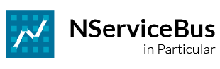



NServiceBus
Developed by Udi Dahan, 2006
Grew out of work in the Aerospace sector
Intended to make messaging easier, durable
Particular Software – mature offering
SLA Management
monitoring
Visual SOA

Slide 7


Systems are not applications
An application has a single executable and runs on a single machine
Usually has a single source of information
Applications don’t know about “connectivity”

Slide 8
“Connectivity” – the network matters
“The 8 fallacies of distributed computing”
The network is reliable
Latency isn’t a problem
Bandwidth isn’t a problem
The network is secure
The topology won’t change
The administrator will know what to do
Transport cost isn’t a problem
The network is homogeneous
Deutsch 94
Gosling 97
Notes:
*Applications vs Systems. – http request! > fall backs?

Slide 9
#1. The network is reliable
Problems!
var c= new OrderService();
c.OrderItem();

Slide 10
#1. The network is reliable
Solutions:
Use reliable messaging infrastructure
MSMQ
ActiveMQ
JMS
Roll your own
Ack & Retry
Store & Forward

Slide 11
What is coupling?
If X depends on Y then:
X is efferently coupled to Y
Y is afferently coupled to X

Slide 12
Coupling at the systems level
Ce: The number of classes in system X that depend on something belonging to system Y
Ca: The number of classes in system Y that something in an external systems depends on

Slide 13
Coupling at the systems level
Ce: The number of classes in system X that depend on something belonging to system Y
If Y changes in some way, how many changes do we have to make in X?
Ca: The number of classes in system Y that something in an external systems depends on
In what ways can we change Y safely?

Slide 14
Loose Coupling at the systems level
Attempt to minimize afferent and efferent coupling
Zero coupling isn’t really possible
3 Different aspects of coupling for systems:
Platform
Temporal
Spatial

Slide 15
Coupling Aspect #2: Temporal
Service A
Service B
Synchronous Call
Waiting
Working
Return
Processing time of Service B affects that of A

Slide 16
Coupling Aspect #2: Temporal - 1
Bad. Resources are held while waiting.

Slide 17
Coupling Aspect #2: Temporal - 2
Resources are held while waiting. Increased load on service B per consumer (impacted by polling interval)

Slide 18
Coupling Aspect #2: Temporal - final
Good. By separating (in time) the inter-service communication and the request handling

Slide 19
Why Messaging?
Reduces coupling
Use XML for platform coupling
Use asynchronous messaging for temporal coupling
Reduces afferent and efferent coupling while increasing autonomy

Slide 20
Performance – RPC vs Messaging
Throughput
Messaging
RPC
Load
With RPC, threads are allocated with load
With messaging, threads are independent
Difference based on blocking nature of comms.
Memory, DB locks, held longer with RPC

Slide 21
Asynchronous Messaging
It’s all about one-way, fire & forget messages
Everything is built on top of it
Return Address pattern
Correlated Request/Response
Publish/Subscribe

Slide 22
One-way, fire & forget messaging
Initiating Service
Target Service
Sends, and keeps on working
Id
Each message has an Id.
Seems simple, but there’s more to it.

Slide 23
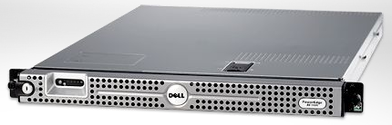

Server
MSMQ
Outgoing Incoming
Store and Forward
adds resilience
MSMQ
Outgoing Incoming
Client

Slide 24
Standard message handling
Customer Service
void Change_Address(Guid id, Address a);
void Make_Preferred(Guid id);
void Change_Credit(Guid id, Credit c);
Problem is that service layers get too large
Difficult for multiple developers to collaborate
Difficult to reuse logging, authorization, etc

Slide 25
Exploit strongly-typed messages
IMessage
where T : IMessage
IHandleMessages<T>
void Handle(T message);

Slide 26
Represent methods as messages
IMessage
Change_Address_Msg
Make_Preferred_Msg
Change_Credit_Msg

Slide 27
Handling Logic Separated
IHandleMessages<T>
void Handle(T message);
H1:
IHandleMessages<Change_Address_Msg>
H2:
IHandleMessages<Make_Preferred_Msg>
H3:
IHandleMessages<Change_Credit_Msg>

Slide 28
Fault-tolerance - scenarios
When servers crash
When databases are down
When deadlocks occur in the database

Slide 29


When Servers Crash
[HTTP] $$ Order
DB
App
Tx
Call 1 of 3
Call 2 of 3
Critical Windows Patch
Rollback
Where’s the order!?
Notes:
The DB is consistent - but the order isn’t there.
When the App comes back up again, the order isn’t in memory, or on the network stack.
Are you hoping the user will click “submit” again? Or that the external system will resubmit?
That’s OK - these days you don’t get a critical patch more than once every 2-3 days.
Also, consider what happens if the DB is down. The App gets some kind of exception, it writes it to the log, and moves on. At least we know that the reason that the order disappeared is logged.

Slide 30
When Databases Are Down
[HTTP] $$ Order
Call 1 of 3
DB
App
Tx
Exception
Write to log
Down
Where’s the order!?
Notes:
At least we know that the reason that the order disappeared is logged.

Slide 31

When Deadlocks Happen
[HTTP] $$ Order
DB
App
Tx
Call 1 of 3
Call 2 of 3
Exception
Write to log
A
B
Where’s the order!?
Deadlock
Notes:
Deadlocks happen all the time in production databases - just ask your DBA.
By the way, the only thing to do is usually to retry (up to a point). Of course, you’re susceptible to restarts during those retries.

Slide 32
How Does Messaging Help?
Rollback
Tx
$$ Order
Q
Receive
Rollback
App
Call 1 of 3
DB
Call 2 of 3
The order is back in the queue
Notes:
Actually, in order to support this scenario, in-memory messaging isn’t enough - we need durable messaging. In the other cases where the DB is down or there’s a deadlock will work fine for in-memory messaging.

Slide 33

Calling Web Services
Rollback
$$ Order
A
B
C
D
Not Rolled back
[HTTP] Invoke
DB
WS
Deadlock

Slide 34
Web Services with Messaging
The message won’t be sent if there’s a failure
$$ Order
A
B
C
D
Msg
[HTTP] Invoke
Messaging
Gateway
DB
WS

Slide 35
Broker Architectural Style
Initiator requests a service from the broker
Broker performs per request or per connection routing
Service B
Service A
Broker
Service C
Service D

Slide 36
Bus Architectural Style
Event sources and sinks communicate via channels in the bus
Source place events (messages) in channels, sinks are notified about message availability
Source
Sink
Bus
Sink
Source

Slide 37
Bus Topology
App
App
Bus.dll
Bus.dll
App
App
Bus.dll
Bus.dll
App
App
Bus.dll
Bus.dll
App
App
Bus.dll
Bus.dll

Slide 38
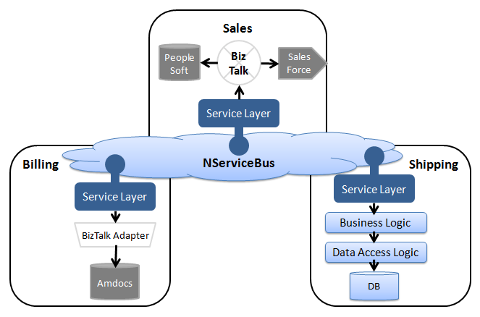
The best of both worlds

Slide 39
Event Driven Architecture
Concepts
The other side of the SOA coin
Events in EDA, not commands
Informational – be explicit about events
Fire and Forget Messaging
Notes:
* CRUD vs Events - meaningful

Slide 40
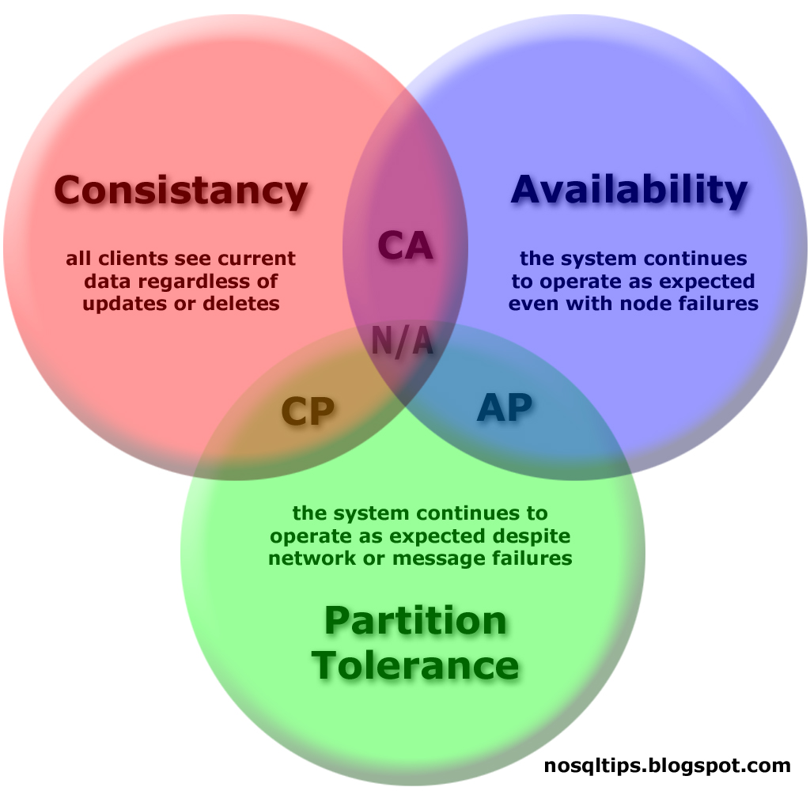
Event Driven Architecture
CAP Theorem and Eventual Consistency
States you can only have 2 of 3
Eventual Consistency & NSB
NSB opts for “A” and “P” over “C”

Slide 41
Event Driven Architecture
General Guidelines
Paradigm shift; stop trying to apply the same concepts
Keep your messages small
A single message will generally map to a traditional use case
An event is traditionally owned by a single authoritative owner
Name events by what business case occurred,
not by the desired handler behavior
Plan for versioning

Slide 42
What is a service?
4 Tenets of Service Orientation:
1. Services are autonomous.
2. Services have explicit boundaries
3. Services share contract & schema,
not class or type
4. Service interaction is controlled by policy.

Slide 43
What is a service?
A service is the technical authority for a specific business capability.
All data and business rules reside within the service.

Slide 44
What a service is NOT
A service that has only functionality is a function,
not a service.
Like check if order is valid
A service that has only data is a database,
not a service.
Like [create, read, update, delete] entity

Slide 45

Service Examples
Place Order
Sales
Save status locally
Save pricing locally
Subscribe to Product Pricing Updated
Subscribe to Customer Status Updated
Publish
Product Pricing Updated
Publish
Customer Status Updated
Customer Care
Marketing
Publish Order Accepted

Slide 46
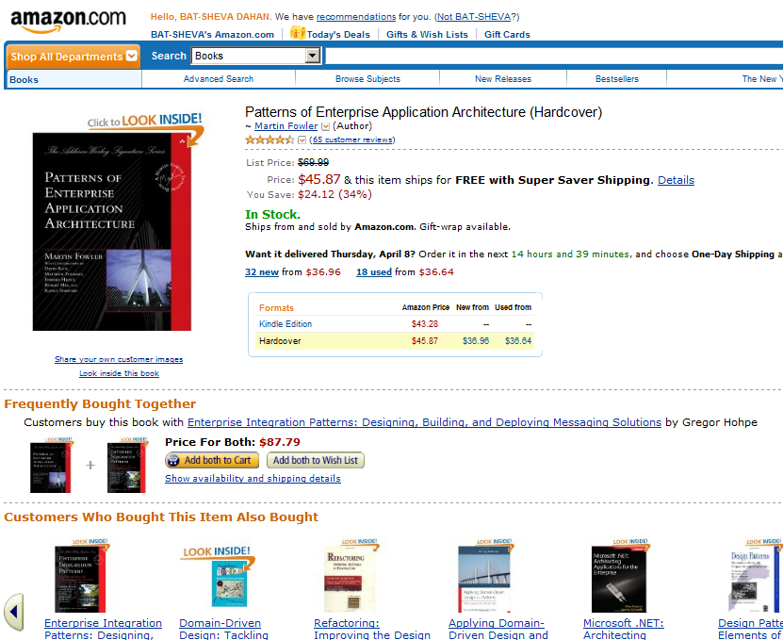
Which service owns this page?

Slide 47
Which service owns this page?
None

Slide 48
Technical properties of a service
A service may have multiple end points
A service may communicate over multiple protocols and transports
A service is responsible for its own availability and scalability

Slide 49
Contracts and Schemas
Schema defines the logical message types
Contract provides additional technical info:
Online messaging channel
TimeToBeReceived – 1 minute
Hourly ftp batch channel
TimeToBeReceived – practically infinite
Subscribers choose the appropriate contract based on their availability

Slide 50
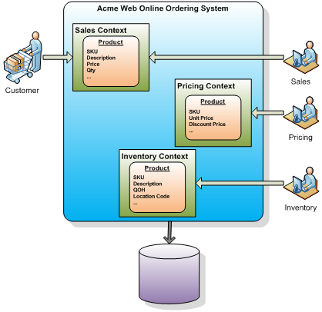

Bounded Contexts
Popularized by Eric Evans
EDA, NSB relevance
Inter-cellular communication

Slide 51
NServiceBus
Development – Guidelines – Gotchas!
Let NServiceBus handle errors
Keep message handlers small and fast
Utilize unobtrusive mode
Make handlers idempotent (ALO)
Each service should form a bounded context
Use interface definitions for events for versioning
Be aware of how saga state concurrency works

Slide 52
NServiceBus
Customers

Slide 53

NServiceBus & AI
Customers

Slide 54

thank you
for your time

Slide 55
Current model vs NSB model

Slide 56
Distributors – How it works with Nservicebus
Error Queues – Example
Logical endpoints vs Physical endpoints
Logging

Slide 57
Pain Points

Slide 58
Experiences with Other Clients

Slide 59
Monitoring Queues
Alerts with Splunk integrating into it

Slide 60
ServicePulse
ServicePulse Web

Slide 61


End-to-end Operational Monitoring
for Distributed Applications
Highlighted Features:
Endpoint heartbeat monitoring
Failed messages detection and management (retry, details)
Extensible Custom Checks
Process SLA definition, monitoring and alerting
SLR indications and trends
Endpoint restarts and configuration changes detection
Performance Counters: OOTB Endpoint-level and centralized monitoring
ServicePulse Web: Lightweight standalone & dynamic web app
ServicePulse Plugin: Integrate ServicePulse with leading Operations suites
Introduction to ServiceInsight for NServiceBus
Introduction to ServicePulse for NServiceBus

Slide 62





Architecture Overview
ServicePulse
ServicePulse Plugin for 3rd Party Ops suites
ServiceControl
Audit Q
Endpoint
Endpoint
Endpoint
Error Q
Endpoint
Endpoint
ServiceInsight
Introduction to ServiceInsight for NServiceBus
Introduction to ServicePulse for NServiceBus

Slide 63
Endpoint Heartbeats
ServicePulse
ServiceControl
Audit Q
Endpoint
Endpoint
Endpoint
Error Q
Endpoint
Endpoint
ServicePulse notifies when heartbeats are not received as expected
Heartbeats received and monitored by SC.
Endpoints start sending hearbeat messages (default: every 30 sec)
Drop Heartbeat.plugin.dll into the endpoint’s bin directory
Introduction to ServiceInsight for NServiceBus
Introduction to ServicePulse for NServiceBus

Slide 64
Custom Checks
ServicePulse
ServiceControl
Audit Q
Endpoint
Endpoint
Endpoint
Error Q
Endpoint
Endpoint
ServicePulse notifies when Custom Checks events are raised or cleared
Custom checks events received and stored in SC
Endpoints periodically (or on-demand) run custom checks
Drop custom checkl dll into the endpoint’s bin directory
Code the check in a class that inherits from PeriodicCheck
(See GH repo issue ServicePulse #16)
Introduction to ServiceInsight for NServiceBus
Introduction to ServicePulse for NServiceBus

Slide 65
Failed Messages
ServicePulse
ServiceControl
Audit Q
Endpoint
Endpoint
Endpoint
Error Q
Endpoint
Endpoint
Indicators detect Failed Messages, which can be Retried (or cleared) via SP UI
SC consumes failed messages from Error Q
Introduction to ServiceInsight for NServiceBus
Introduction to ServicePulse for NServiceBus

Slide 66
Endpoint Restarts and Configuration Changes
ServicePulse
ServiceControl
Audit Q
Endpoint
Endpoint
Endpoint
Error Q
Endpoint
Endpoint
Indicators notify of endpoint restarts, version updates and configuration changes
SC collects and monitors changes to restart, version and configuration settings
Heartbeat messages include endpoint restarts, version and configuration settings
Introduction to ServiceInsight for NServiceBus
Introduction to ServicePulse for NServiceBus

Slide 67
End-to-end Operational Monitoring
for Distributed Applications
Highlighted Features:
Endpoint heartbeat monitoring
Failed messages detection and management (retry, details)
Extensible Custom Checks
Process SLA definition, monitoring and alerting
SLR indications and trends
Endpoint restarts and configuration changes detection
Performance Counters: OOTB Endpoint-level and centralized monitoring
ServicePulse Web: Lightweight standalone & dynamic web app
ServicePulse Plugin: Integrate ServicePulse with leading Operations suites
Beta (Nov 2013)
Post RTW
(Jan 2014)
Post RTW
(Jan 2014)
Introduction to ServiceInsight for NServiceBus
Introduction to ServicePulse for NServiceBus

Slide 68
http://particular.net/blog/an-introduction-to-servicepulse-for-nservicebus

Slide 69
thank you
for your time

Slide 70
Commands & Events
Commands
Represents something you WANT to happen
Meant for one recipient
Can be sent by multiple endpoints
Can utilize Bus.Return to return success codes
Events
Represents something that ALREADY happened
Meant for many recipients
Can be sent by only one authoritative endpoint

Slide 71
Session 2
*Comparing existing and new model
Samples
*Pub / Sub
*Sagas
*ServiceInsight
*Distributors
Extension Points
Customization

Slide 72
Comparing Existing and New
Benefits
--Pub / Sub
--EDA
--Easier to develop and debug.
--Easier to add new processes and functionality
--Sagas and Workflow management
Down Side?
Lots of processes - management for OPs
new paradigm in development and thinking.

Slide 73
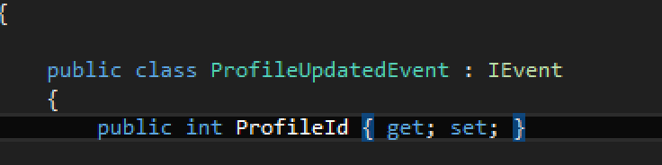
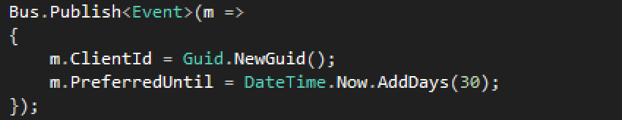
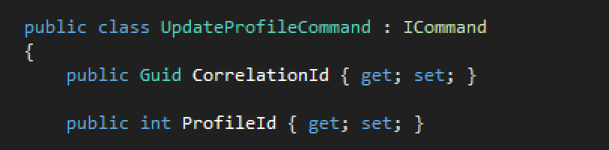
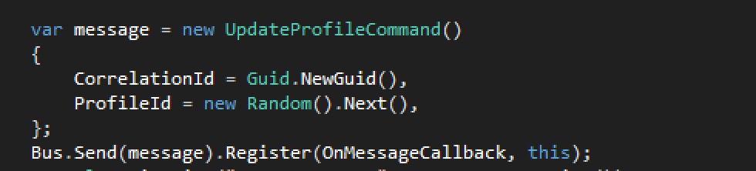
Commands & Events
Examples

Slide 74

Subscriber
Publisher
Subscribe
Subscriber
Subscriber
Subscriber
Subscriber

Slide 75
Subscriber
Publisher
abcdefgh
Subscriber
abcdefgh
Subscriber
abcdefgh
Subscriber
abcdefgh
abcdefgh
Subscriber

Slide 76
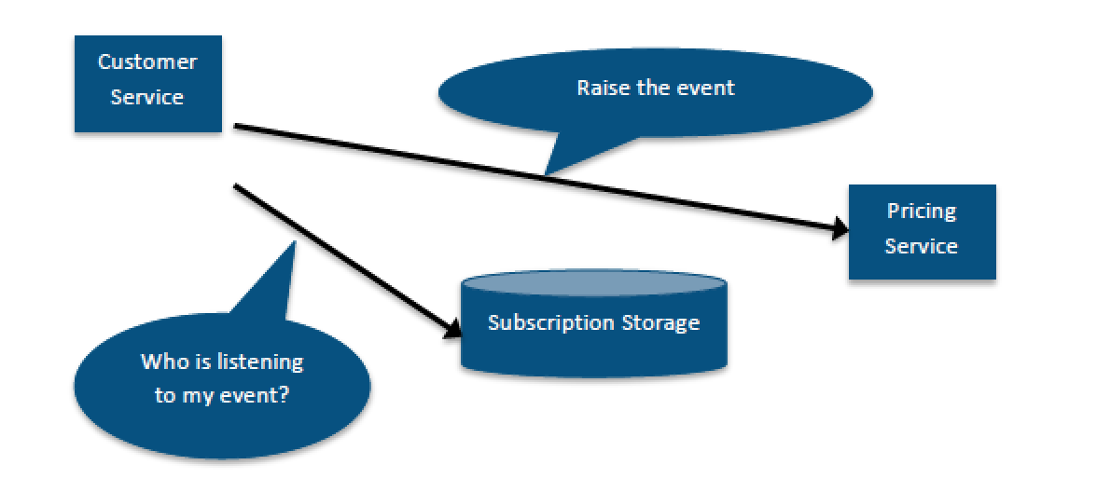
Events
Subscription Storage

Slide 77
Sagas
Sagas
Long running workflows
Can be started by multiple events or commands
Can handle many types of events and/or commands
Can receive timeout events
Compensate for failures or timeouts
Saga Data
Represents data related to the workflow
Stored in RavenDB or in SQL Server

Slide 78
Out-of-order events
Order Accepted
Sales
Billing
Order Accepted
Order Billed
Now waits for OrderBilled
which won’t arrive again
Shipping
Can’t find order in DB
Throws away the message

Slide 79
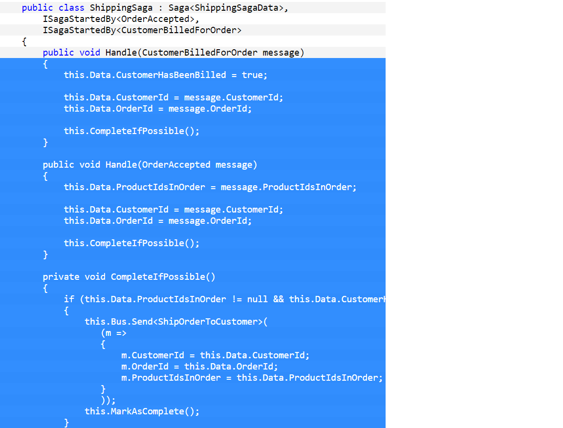
Sagas
Example

Slide 80
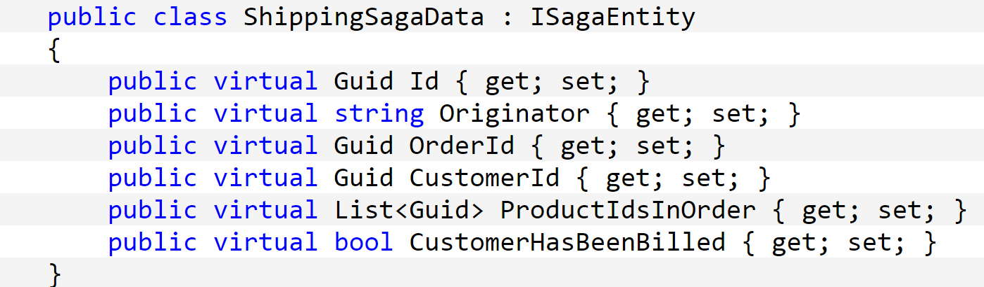
Saga Data

Slide 81
Profiles & Roles
Environment Profiles
• NServiceBus.Lite – Intended for development environments. All
logging is performed to the console, and all storage is handled in
memory.
• NServiceBus.Integration – Intended for test/QA environments. All
logging is performed to the console with a default threshold of INFO,
and durable persistence stores handle all data storage.
• NServiceBus.Production – Intended for production environments. All
logging is performed to the file system, and durable persistence stores
handle all data storage. Additionally, performance counters will be
enabled.
Feature Profiles
• NServiceBus.Distributor – Configures the endpoint as a master node
that runs the distributor with no worker on its endpoint.
• NServiceBus.Master – Configures the endpoint as a master node that
runs the distributor with a worker on its endpoint.
• NServiceBus.MultiSite – Runs the NServiceBus gateway component,
which is intended for MultiSite messaging.
• NServiceBus.PerformanceCounters – Enables performance counters
within the endpoint.
• NServiceBus.Worker – Configures the endpoint as a worker node, and
enlists with the distributor on the specified master node.

Slide 82
Self Hosting
Useful when embedding inside web applications or other existing applications
Enormous amount of freedom in how the bus is configured and setup
Fluent configuration API to configure the bus

Slide 83
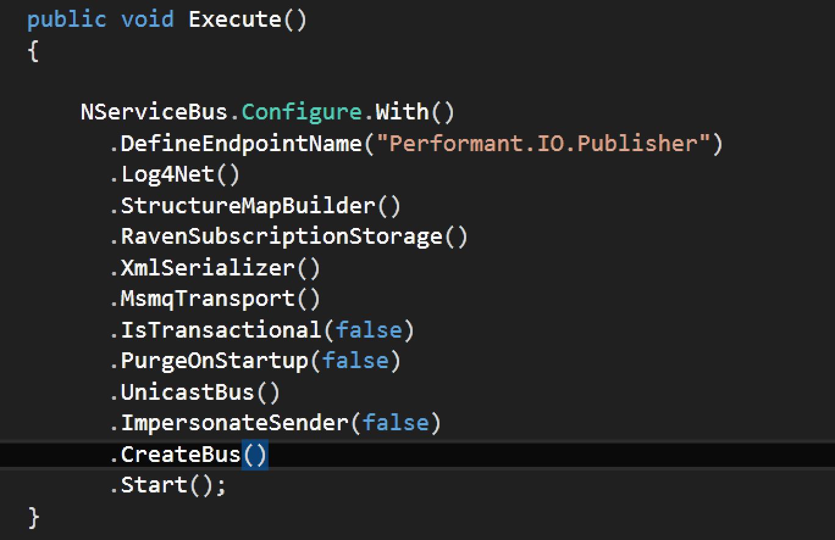
Self Hosting
Example

Slide 84
NServiceBus Distributor
Introduction
Software load balancer
Scaling Out
Profiles
Distributor Internal Queues
Control
Data

Slide 85
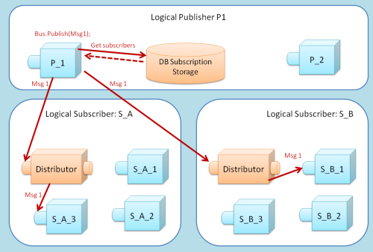
Distributors & Workers

Slide 86
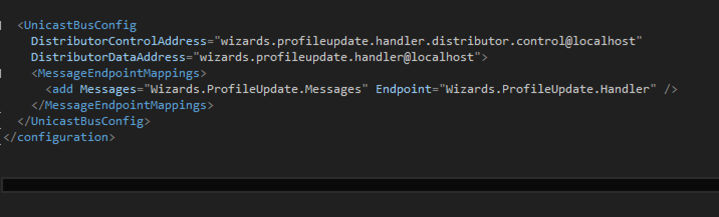
Distributors & Workers
Example
NSB Profiles
NServiceBus.Master
NServiceBus.Distributor
NServiceBus.Worker

Slide 87
NServiceBus
Extension Points
Transports
IoC Container
Serialization
Logging
Saga Persistence
Message Mutation
Timeout Manager
Others…

Slide 88
NServiceBus
General Extension Points
IWantCustomLogging
IWantToRunBeforeConfiguration
IWantCustomInitialization
INeedInitialization
IWantToRunBeforeConfigurationIsFinalized
IWantToRunWhenConfigurationIsComplete
IWantToRunWhenTheBusStartsAndStops

Slide 89
NServiceBus
Transports
HTTP/HTTPS
FTP
MSMQ
WCF
RabbitMQ
ActiveMQ
WebSphereMQ
Azure
SQL Server Queuing
In-Memory *not recommended for production usage
Custom via implementing interfaces

Slide 90
NServiceBus
IoC Container
Castle Windsor
StructureMap
Unity
Autofac
Spring.NET
Custom via implementing interfaces

Slide 91
NServiceBus
Serialization
Xml
Json
Bson
Binary
Custom

Slide 92
NServiceBus
Performance Counters
• Critical Time – Monitors the time elapsed between the time a message is
sent and the time it is successfully processed
• Time to SLA Breach – Utilizes configured SLA requirements in order to
monitor the time remaining until an SLA breach for messages currently
being processed
• Number of Message Failures/Sec – The number of message failures per
second
• Number of Messages Pulled from the Input Queue/Sec – The number of
messages pulled from the input queue per second
• Number of Messages Successfully Processed/Sec – The number of
messages successfully processed by a message handler per second

Slide 93
NServiceBus
Advanced Topics: Days 2 - 4
Second Level Retries
Throttling
CEP (Complex Event Processing)
Attachments (Large Messages)
Delivery Policies (OAOO, ALO, BE)
Monitoring
Deferred Messaging
Encryption
Message Mutation
Polymorphic Dispatch
Message Expiration
more…

Slide 94
CQRS
Command Query Responsibility Segregation
Reduces complexity
Task Based UI
Event Sourcing
Ability to store and replay events
Eventual Consistency
Sacrifice short term consistency for availability and fault tolerance
Encapsulates domain completely

Slide 95
CQRS
Command Query Responsibility Segregation

Slide 96
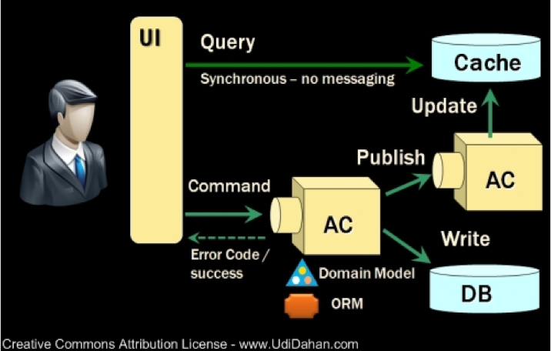
CQRS
Command Query Responsibility Segregation

Slide 97
CQRS
References
http://www.ncqrs.org
https://github.com/ncqrs
http://codebetter.com/gregyoung/

Slide 98
Resources
Interesting Authors & Noteworthy Sources
Udi Dahan
http://www.udidahan.com
Author of NServiceBus
Ayende (Oren Eini)
http://www.ayende.com
Author of Nhibernate, NH Profiler, RhinoDSL
Jeremy D. Miller
http://jeremydmiller.com
Author of StructureMap, Flueent NH
Greg Young
http://goodenoughsoftware.net/
CQRS specialist
Eric Evans
http://www.amazon.com/Domain-Driven-Design-Tackling-Complexity-Software/dp/0321125215
DDD Author
Roy Osherove
http://osherove.com/blog/
Author of “The Art of Unit Testing”

Slide 99
thank you
for your time

